Slide 1
Lambda Architecture
©2015 ITC Infotech. All Rights Reserved.

Slide 2
What is Lambda Architecture?
Lambda architecture is a data processing architecture designed to handle massive quantities of data by taking advantage of both batch and stream processing methods.

Slide 3
Lambda Architecture Overview
λ has three layers:
The Batch Layer manages the master data and pre-computes the batch views.
The Speed Layer serves recent data only and increments the real-time views.
The Serving Layer is responsible for indexing and exposing the views so that they can be queried.

Slide 4
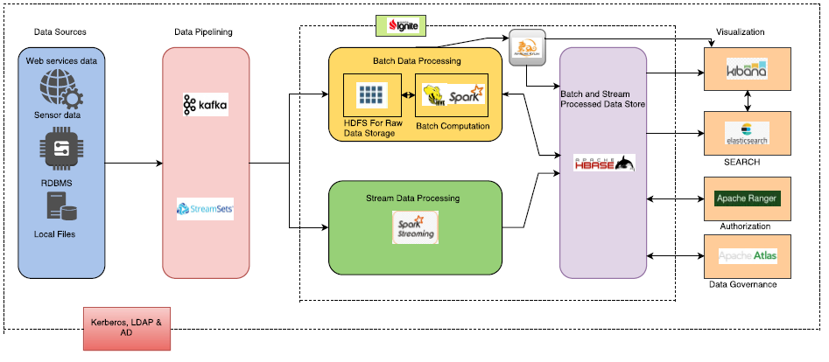
Architecture
Talend Open Studio for Data Quality

Slide 5
Data Pipeline Component Overview
Kafka: High-throughput, low-latency platform for handling real-time data feeds. Used for Data flows to and from streamsets/data sources.
Streamsets: StreamSets Data Collector is open-source, in-memory big data ingest infrastructure that lets you develop and operate highly-adaptable ingest pipelines.

Slide 6
Data Pipeline Component Overview
Talend Open Studio for Data Quality allows you to create clean, trusted data within any style of integration. Profile, cleanse, enrich and manage data from any data source.

Slide 7
Batch Layer Component Overview
HDFS is used as a raw data storage which provides reliable data storage.
Hive LLAP: Provides interactive Low Latency Analytical Processing (LLAP) functionality which performs better than impala.
Spark Core: Is used for batch data processing. Preferred over others due to good developer community support.

Slide 8
Streaming Layer Component Overview
Spark Streaming is used for processing streaming data pipelined from streamsets. Though it doesn’t provide real-time processing, it has been used as it is more matured and has better developer community support.

Slide 9
Serving Layer Component Overview
Hbase is used as a preferred storage layer over others due to its compatibility with Kylin. Moreover it can be a better database to merge data from streaming and batch layers.
Apache Ignite is an in-memory computing platform that delivers unprecedented speed and unlimited scale for modern data processing and storage.

Slide 10
Data warehousing Component Overview
Apache Kylin is for Distributed Analytics Engine designed to provide SQL interface and multi-dimensional analysis (OLAP) on Hadoop supporting extremely large datasets. It used mapreduce and spark engines for processing. Collects data from hive and stores the dimensioned data to hbase.

Slide 11
Search & Visualization Component Overview
Elastic search provides highly scalable full-text search and analytics engine. It is generally used as the underlying engine/technology that powers applications that have complex search features and requirements. It can use Hbase as storage rather than having its own storage.
Kibana provides visualization capabilities on top of the content indexed using elastic search.

Slide 12
Security Component Overview
Apache Ranger and Atlas provide data governance and authorization on the hadoop components.
Kerberos, LDAP and AD are used for robust authentication.

Slide 13
Queries ?
©2015 ITC Infotech. All Rights Reserved.

